Slide 1
Heart disease Report
Safika parween

Slide 2
Index No. | Title | Page No
1 | Introduction | 3
2 | Objective | 4
3 | Data Sharing Agreement | 5
5 | Insights | 6
6 | design | 7

Slide 3
INTRODUCTION
Heart disease is a pervasive global health challenge, demanding early and precise diagnosis. Leveraging advancements in medical technology and data analytics, this study explores a holistic diagnostic approach. Integrating diverse datasets, including medical records and genetic information, our aim is to develop a comprehensive framework using AI and machine learning. By addressing challenges such as personalized diagnostics and multi-modal data integration, we strive to contribute to the evolution of tailored strategies. Ultimately, this analysis seeks to usher in a new era of precision medicine for heart diseases, enhancing diagnostic accuracy, improving patient outcomes, and fostering proactive and personalized cardiovascular care.

Slide 4
OBJECTIVE
Using Power BI, analyze heart disease data to identify key factors influencing risk. Create interactive dashboards displaying trends, correlations, and predictive insights. Utilize geospatial analysis if applicable to visualize regional disparities. Provide actionable recommendations based on findings to improve public health strategies

Slide 5
DATA SHARING AGGREMENT
File Name: Heart disease .csv
Dataset Size : 11.0KB
Number of Rows: 304
Number of columns: 14

Slide 6
INSIGHTS
Heart Disease ratio
Chest Pain By Heart Disease
Cholestoral,Blood Pressure, Heart Rate
ST depression And Heart Disease

Slide 7
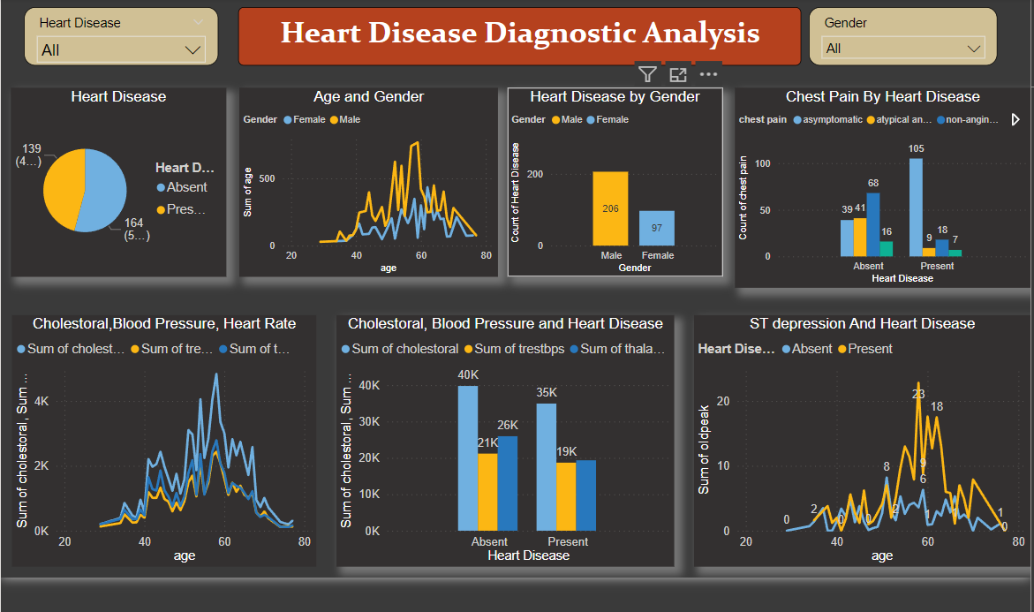
my design

Slide 8
Thank you

